Slide 1


Prepared by: Ivy Mohlala – Student
Business Insights for Revenue Growth

Slide 2
Project Overview
Purpose: Analyse sales data to uncover trends.
Tools: Snowflake, Excel,Canva,Miro
Data Source: Bright Coffee Shop Transactions CSV

Slide 3
Key Questions
Which products generate the most revenue?
What time of day does the store perform best?
Which products need improvement?

Slide 4
Insight: Espresso drives the majority of revenue.

Slide 5
Items Sold by Product Category
Insight: Drinks dominate sales volume.

Slide 6
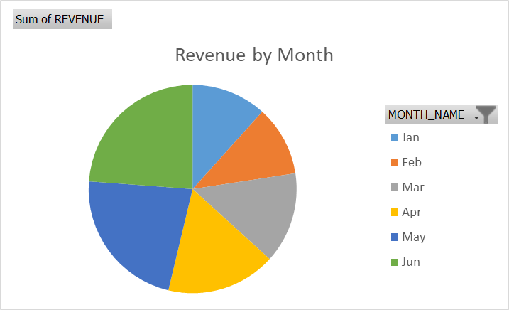
Revenue by Month:
Customers prefer warm drinks when it’s cold.

Slide 7
Recommendations:
Stock more of top-selling products
Increase marketing during slow hours
Promote underperforming items
Implement loyalty programs

Slide 8
Conclusion:
Data-driven insights will help optimize revenue, improve stock management, and enhance customer engagement.

